Slide 1
An Overview of the South Bend Schools Federal Consent Decree
Cowardice asks the question, is it safe?
Expediency asks the question, is it polite?
Vanity asks the question, is it popular?
But conscience asks the question, is it right?
And there comes a time when one must take a position that is
Neither safe nor polite nor popular
But one must take it, because it is right!
~ Dr. Martin Luther King, Jr.
South Bend NAACP Branch, Community Action for Education (CAFÉ), in partnership with the Community Forum for Economic Justice

Slide 2
The South Bend Community Schools Corporation Federal Consent Decree
What it is – A binding agreement between the Federal Court and SBCSC.
What it does – Eradicate patterns of racial discrimination to ensure equal opportunities for every child.
Why we still need it – To ensure equal access to educational resources and fairness in treatment for every student.
Notes:
Objectives
What is a Consent Decree?
Why did South Bend need a Consent Decree?
How does it protect us?
Why we still need it.

Slide 3
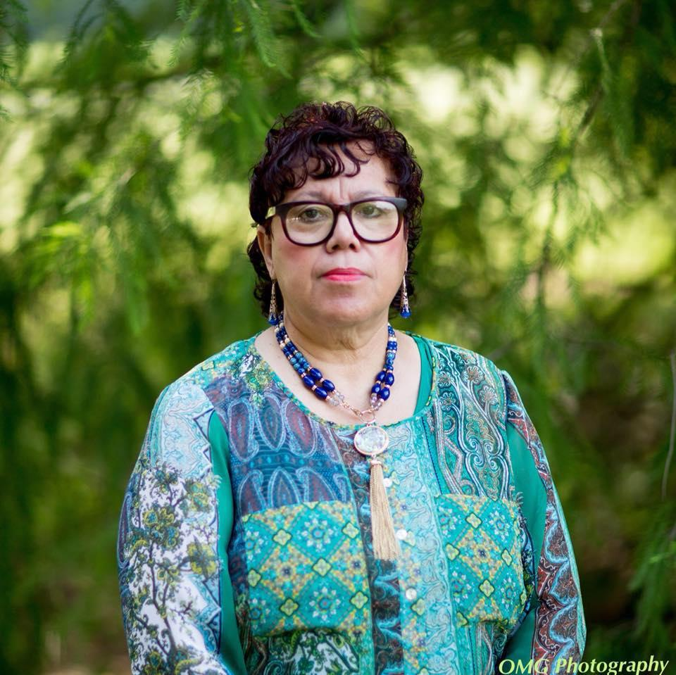
Introduction
“In light of, the conversation or dare I say debate brewing over the relevance of the 1981 SBCSC Consent Decree the South Bend NAACP would like to point out some of the historical facts surrounding the Order and why it is imperative we maintain it. It is important to learn from the past and apply it to the present. In regard to the Consent Decree, our position today is what it has always been: It’s the law, it is relevant, and very much needed.”
Oletha Jones
Education Chairperson
South Bend NAACP
Notes:
Objectives
What is a Consent Decree?
Why did South Bend need a Consent Decree?
How does it protect us?
Why we still need it.

Slide 4
Documents
The Consent Decree has a long and non-linear history. Over the course of time, some issues occurred simultaneously. This presentation will focus on the most important points, based on the following documents:
1980 Federal Consent Decree
Plan Z Amendment
Focus 2018 Amendment
Focus 2018 Stipulation
2020 Modified Stipulation
Vision Statement on Racial Equity and Antiracist policy in SBCSC
Notes:
Objectives
What is a Consent Decree?
Why did South Bend need a Consent Decree?
How does it protect us?
Why we still need it.

Slide 5
South Bend and Segregation
Even after the 1954 Supreme Court decision, Brown v Board of Education, made the concept of “separate but equal” illegal, SBCSC was slow to eliminate segregated schools. After the roof collapse of the all-Black Linden School in 1966, activists organized to demand full integration and equal access to educational resources for all children. It took years but the DOJ ultimately sued SBCSC for its failure to comply with the Supreme Court’s Brown v Board decision.
In May 1980, the United States of America and South Bend Community Schools Corp entered into a Consent Decree.
Notes:
Objectives
What is a Consent Decree?
Why did South Bend need a Consent Decree?
How does it protect us?
Why we still need it.

Slide 6
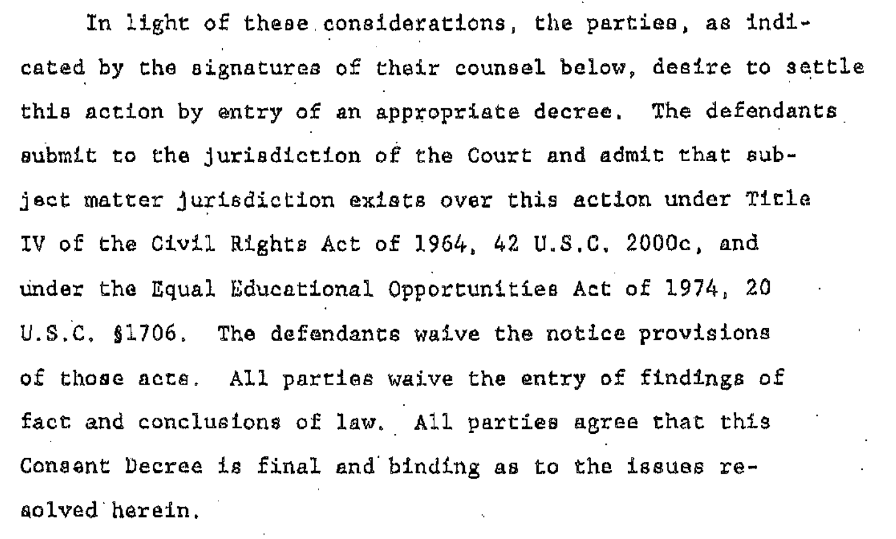
What Is the Consent Decree?
A settlement approved by the court … final and binding
From UNITED STATES OF AMERICA, Plaintiff, v. SOUTH BEND COMMUNITY SCHOOL CORPORATION, et al., Defendants.
Notes:
Objectives
What is a Consent Decree?
Why did South Bend need a Consent Decree?
How does it protect us?
Why we still need it.

Slide 7
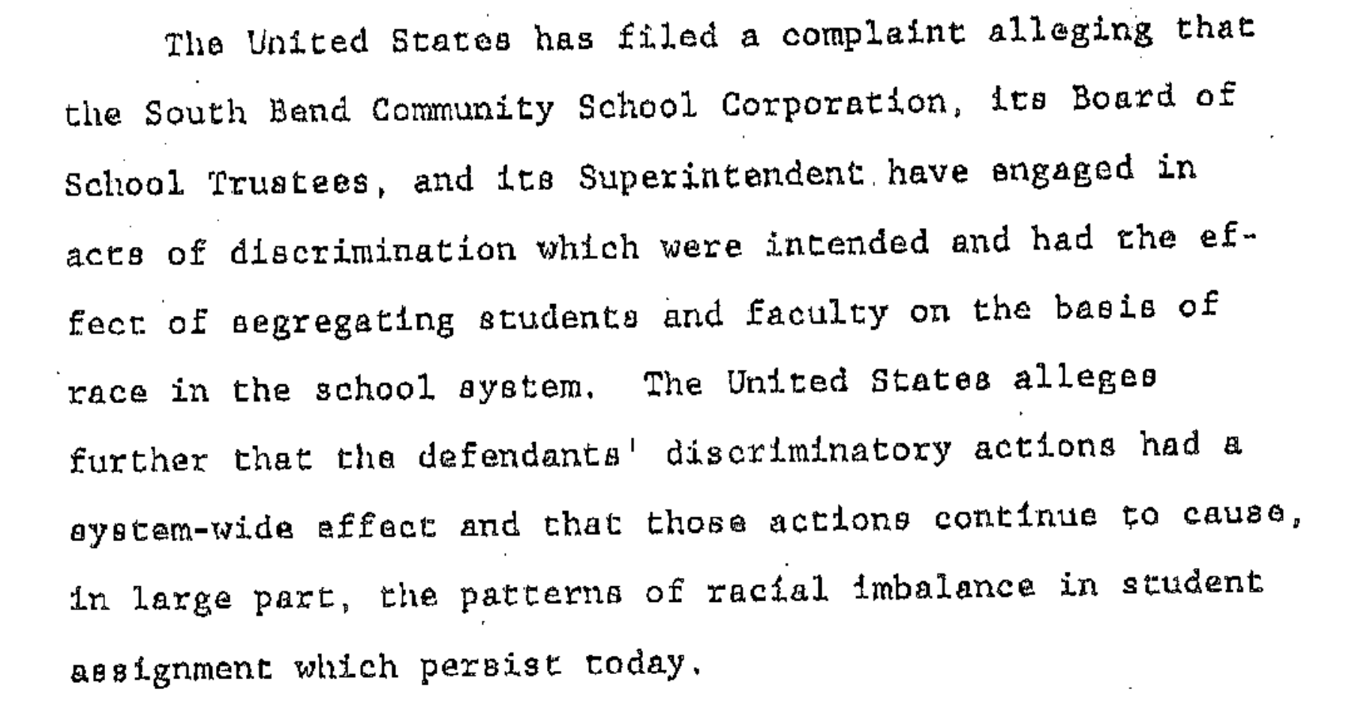
What Was the Complaint?
From UNITED STATES OF AMERICA, Plaintiff, v. SOUTH BEND COMMUNITY SCHOOL CORPORATION, et al., Defendants.
Notes:
Objectives
What is a Consent Decree?
Why did South Bend need a Consent Decree?
How does it protect us?
Why we still need it.

Slide 8
What Did the Parties Agree To?
From UNITED STATES OF AMERICA, Plaintiff, v. SOUTH BEND COMMUNITY SCHOOL CORPORATION, et al., Defendants.
Notes:
Objectives
What is a Consent Decree?
Why did South Bend need a Consent Decree?
How does it protect us?
Why we still need it.

Slide 9
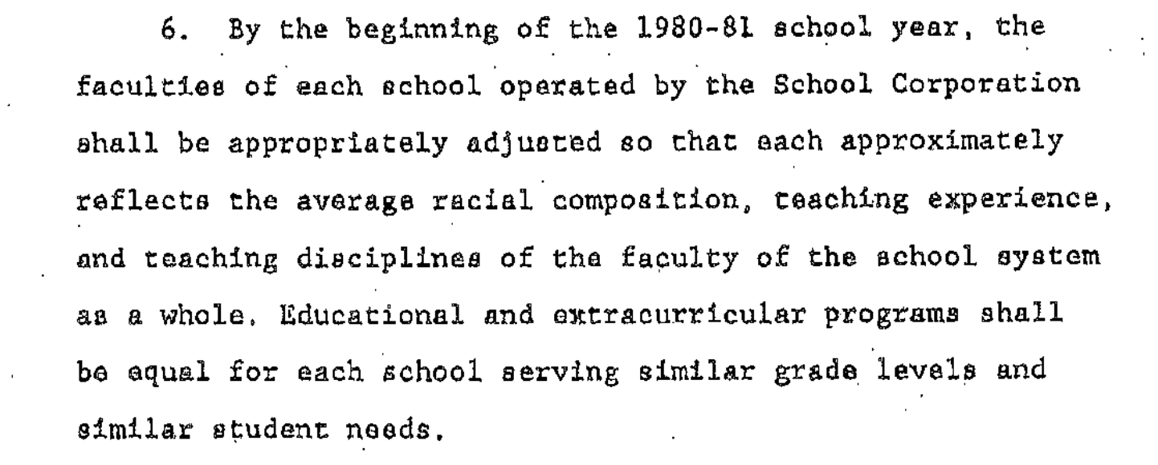
What Did the Parties Agree To?
Every school shall have the benefit of experienced teaching staff. Students in each school shall have equal access to rich programs both in school and after-school.
From UNITED STATES OF AMERICA, Plaintiff, v. SOUTH BEND COMMUNITY SCHOOL CORPORATION, et al., Defendants.
Notes:
Objectives
What is a Consent Decree?
Why did South Bend need a Consent Decree?
How does it protect us?
Why we still need it.

Slide 10
What Did the Parties Agree To?
This lays the foundation for universal professional expectations. As of 2023, this part of the decree has never been fully and equitably implemented. The issue of a uniform Student Code of Conduct continues to be a challenge.
From UNITED STATES OF AMERICA, Plaintiff, v. SOUTH BEND COMMUNITY SCHOOL CORPORATION, et al., Defendants.
Notes:
Objectives
What is a Consent Decree?
Why did South Bend need a Consent Decree?
How does it protect us?
Why we still need it.

Slide 11
What Did the Parties Agree To?
From UNITED STATES OF AMERICA, Plaintiff, v. SOUTH BEND COMMUNITY SCHOOL CORPORATION, et al., Defendants.
Notes:
Objectives
What is a Consent Decree?
Why did South Bend need a Consent Decree?
How does it protect us?
Why we still need it.

Slide 12
What Did the Parties Agree To?
The 1980 Consent Decree included a specific deadline to correct the student assignment problem.
From UNITED STATES OF AMERICA, Plaintiff, v. SOUTH BEND COMMUNITY SCHOOL CORPORATION, et al., Defendants.
Notes:
Objectives
What is a Consent Decree?
Why did South Bend need a Consent Decree?
How does it protect us?
Why we still need it.

Slide 13
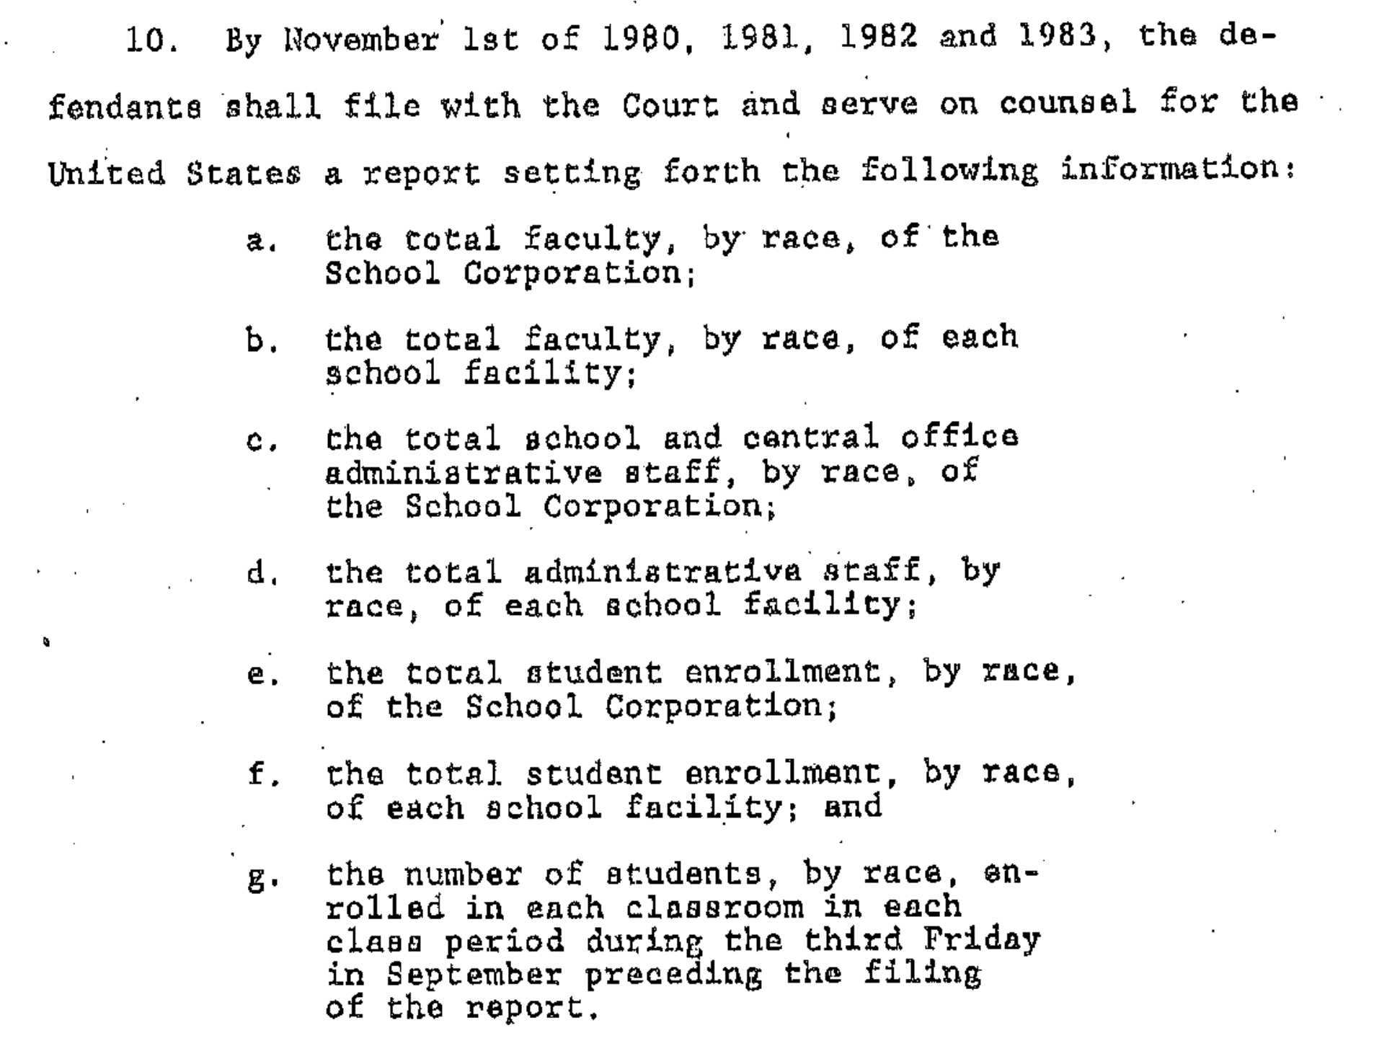
What Did the Parties Agree To?
It is difficult to ascertain if these reports were done and if they continue to this day. Even though Board members were named in the Consent Decree, the Administration does not always share the reports with them.
From UNITED STATES OF AMERICA, Plaintiff, v. SOUTH BEND COMMUNITY SCHOOL CORPORATION, et al., Defendants.
Notes:
Objectives
What is a Consent Decree?
Why did South Bend need a Consent Decree?
How does it protect us?
Why we still need it.

Slide 14
What Did the Parties Agree To?
From UNITED STATES OF AMERICA, Plaintiff, v. SOUTH BEND COMMUNITY SCHOOL CORPORATION, et al., Defendants.
Notes:
Objectives
What is a Consent Decree?
Why did South Bend need a Consent Decree?
How does it protect us?
Why we still need it.

Slide 15
Choice As a Means for Integrating SBCSC
Like many other school districts across the United States, in 1998 the SBCSC Board became interested in the concept of “Choice”, especially as a way to increase voluntary integration and to avoid redistricting.
The SBCSC Superintendent at the time, Dr. Virginia Calvin, expressed grave concerns about the potential for adverse consequences which could result from the proposed Choice program. She detailed these in a thoughtful and well-researched memo.
Memo on School Choice, Dr. Virginia B. Calvin, Superintendent to SBCSC Board of Trustees, July 17, 1998.
Notes:
Objectives
What is a Consent Decree?
Why did South Bend need a Consent Decree?
How does it protect us?
Why we still need it.

Slide 16
Plan Z Amendment
A coalition that included the NAACP and the LaSalle Group filed a lawsuit against the Corporation challenging Plan Z.
The plan advanced under Dr. Joan Raymond, the corporation's new superintendent.
In 2002, the Parties requested court approval of a stipulation to accommodate a massive reorganization program of SBCSC, known as Plan Z. This was in response to fiscal challenges, changes in demographics, as well as pressure to improve learning outcomes.
The Plan included the closing of LaSalle High School, grade level organizational changes, and the creation of new magnet programs. It was controversial and required several rounds of revisions before it was approved by the Court. Dr. Calvin’s memo was included as an Amicus brief to the Court.
Notes:
Objectives
What is a Consent Decree?
Why did South Bend need a Consent Decree?
How does it protect us?
Why we still need it.

Slide 17
Plan Z Amendment
Plan Z proposed assigning primary students closer to their homes. Voluntary measures of “controlled choice” were deemed acceptable for primary centers.
From UNITED STATES OF AMERICA, Plaintiff v SOUTH BEND COMMUNITY SCHOOL CORPORATION, Defendant, Cause No. S80 – 0035, 2002 Stipulation to Approve Plan Z
Notes:
Objectives
What is a Consent Decree?
Why did South Bend need a Consent Decree?
How does it protect us?
Why we still need it.

Slide 18
Plan Z Amendment
Plan Z also created LaSalle Intermediate Academy, Kennedy Academy, and other Magnet Programs.
From UNITED STATES OF AMERICA, Plaintiff v SOUTH BEND COMMUNITY SCHOOL CORPORATION, Defendant, Cause No. S80 – 0035, 2002 Stipulation to Approve Plan Z
Notes:
Objectives
What is a Consent Decree?
Why did South Bend need a Consent Decree?
How does it protect us?
Why we still need it.

Slide 19
The Consequences of Plan Z
Plan Z failed to ensure compliance with the Consent Decree and learning outcomes did not improve. Closing LaSalle High School shifted the problem of having one high school where Blacks were disproportionately concentrated to Washington HS. The percentage of white children attending SBCSC schools declined rapidly. The number of primary centers out of compliance was the same at the end as at the beginning of the fifteen-year period, but fewer schools failed because the percentage of Black students was too high while the number of primary centers with too few Black students rose.
Warlick, J., Have South Bend Schools Become More Segregated? Racial Trends in the SBCSC Since School Year 1996-97. Unpublished. 10/28/2011
Notes:
Objectives
What is a Consent Decree?
Why did South Bend need a Consent Decree?
How does it protect us?
Why we still need it.

Slide 20
The Consequences of Plan Z
Jennifer Warlick, then Associate Professor of Economics at the University of Notre Dame, analyzed enrollment data for the South Bend Community School Corporation to identify trends in the concentrations of African-American students over the fifteen year period beginning defined by the 1996-97 and 2010-11 school years. The results of this analysis were used to answer the question, “Have South Bend’s Public Schools Become More Segregated?”
Warlick, J., Have South Bend Schools Become More Segregated? Racial Trends in the SBCSC Since School Year 1996-97. Unpublished. 10/28/2011
Notes:
Objectives
What is a Consent Decree?
Why did South Bend need a Consent Decree?
How does it protect us?
Why we still need it.

Slide 21
Have South Bend Schools Become More Segregated? (2011)
Dr. Warlick’s Conclusion:
These findings challenge any suggestion that the SBCSC has integrated its schools to the greatest possible extent. They underscore the need for the SBCSC to take actions that will dramatically reduce the concentration of Black students at the primary and intermediate levels, and ensure that no school has a majority of Black students, particularly in high poverty schools. Rather than seeking to escape its current consent decree, the SBCSC should recommit to the goals of desegregation and remedy the problems at its urban core.
During the first decade of the 21st Century, reports from several local institutions indicated that Plan Z had failed to achieve racial diversity in all South Bend schools. During this time, the problem of Disproportionality in Black student discipline and placement in Special Education programs took on greater significance in determining the root causes of poor academic performance.
Warlick, J., Have South Bend Schools Become More Segregated? Racial Trends in the SBCSC Since School Year 1996-97. Unpublished. 10/28/2011
Notes:
Objectives
What is a Consent Decree?
Why did South Bend need a Consent Decree?
How does it protect us?
Why we still need it.

Slide 22
Disproportionality (2008 Statewide Commission)
The concept of Disproportionality (Over-representation for suspensions, expulsions and Special Education referrals in cognitive disability and emotional disability) in US schools
was highlighted in a UN report. Several US presidents called attention to the problem and the Obama administration sued a number of states, including Indiana, for the practice.
The Commission on Disproportionality in Youth Services was created by the 2007 Indiana General Assembly. Trina Robinson and Oletha Jones served on the commission as representatives of the South Bend branch of NAACP.
Notes:
Objectives
What is a Consent Decree?
Why did South Bend need a Consent Decree?
How does it protect us?
Why we still need it.

Slide 23
Findings From the Indiana Commission on Disproportionality Report
Education: African American students are 4 times more likely than white students to be suspended out of school and over 3 times more likely to be expelled.
Juvenile Justice: while African American youth represent only 10% of juveniles in Indiana, they comprise 39% of the youth in Indiana correctional facilities.
Mental Health: African American youth, particularly males, are more likely to be referred to the juvenile justice system rather than the mental health system.
These findings triggered legislation to eliminate discrimination that included the HEA 1419 Disproportionality Law.
Notes:
Objectives
What is a Consent Decree?
Why did South Bend need a Consent Decree?
How does it protect us?
Why we still need it.

Slide 24
Disproportionality and Discipline
"Nearly 40 years of research has almost universally found Black students, Black males in particular, to be overrepresented in the use of exclusionary discipline, out-of-school suspension, and expulsion."
Skiba, R. J., & Williams, N. T. (2014). Are Black kids worse? Myths and facts about racial differences in behavior. The equity project at Indiana University, 1-8. https://indrc.indiana.edu/tools-resources/pdfdisciplineseries/african_american_differential_behavior_031214.pdf
There is no evidence that racial disparities in discipline are due to higher rates of misbehavior by Black students (New Research Brief, p. 2).
If anything, those students are punished more severely for similar or less serious behaviors than their peers (New Research Brief, p. 2).
From: Discipline Disparities: Myths and Facts The Equity Project Center for Evaluation and Education Policy • Indiana University equity@indiana.edu * http://rtpcollaborative.indiana.edu
Notes:
Objectives
What is a Consent Decree?
Why did South Bend need a Consent Decree?
How does it protect us?
Why we still need it.

Slide 25
Disproportionality and Discipline
“Why must advocates for students of color prove that African-American students do not deserve unequal treatment? One might well ask whether the data will ever be sufficient to constitute convincing proof of racial bias for those who believe that discrimination is no longer an issue in American society. Most important, what will it take to persuade the American public in general, and policymakers in particular, that the time has come to eradicate racial disparities in public education and ensure equal access to educational opportunity for all children, regardless of the color of their skin?”
Skiba, R. J., Michael, R. S., Nardo, A. C., & Peterson, R. L. (2002). The Color of Discipline: Sources of Racial and Gender Disproportionality in School Punishment. The Urban Review, 34(4), 338. https://doi.org/10.1023/A:1021320817372
Notes:
Objectives
What is a Consent Decree?
Why did South Bend need a Consent Decree?
How does it protect us?
Why we still need it.

Slide 26
SBCSC and Mishawaka Schools Cited for Non-Compliance
In 2010, SBCSC, School City of Mishawaka, and P-H-M were cited by the state for disproportionately disciplining Black special education students.
https://www.southbendtribune.com/story/news/local/2015/05/26/south-bend-mishawaka-schools-cited-for-noncompliance/45931061/
Notes:
Objectives
What is a Consent Decree?
Why did South Bend need a Consent Decree?
How does it protect us?
Why we still need it.

Slide 27
Multi-Tiered System of Support (MTSS)
In 2011 SBCSC began implementation of the Positive Behavior Intervention Support (PBIS), an intervention for improving behavior and discipline in the school district. “Uniform, substantially equal discipline practices” is requirement 7 in the Court ordered Consent Decree. This intervention was designed in order for school districts to be able to comply with Bill HEA 1419 that requires schools to incorporate discipline rules based on positive behavioral supports, which includes actions that may be taken in lieu of suspension or expulsion.
The local effort to address Disproportionality, known as “The School-to-Prison Pipeline”, was led by local activists and The Community Forum for Economic Justice. They formed CAFÉ (Community Action for Education) in 2015 to raise community awareness of the problem and to advocate for an end to “ticketing” students for behavior infractions.
Notes:
Objectives
What is a Consent Decree?
Why did South Bend need a Consent Decree?
How does it protect us?
Why we still need it.

Slide 28
Consequences of Plan Z and Focus 2018
With the loss of local tax revenue due to tax caps, SBCSC rolled out a new, extensive reorganization plan – Focus 2018 - with no transparency or public input. Focus 2018 was introduced on November 14, 2017 and approved by the Board on December 18, 2017.
The plan was filed in Judge Theresa Springman's Court but then assigned to Judge Phillip Simon of Hammond, Indiana. A ruling was not handed down until June 2018.
“Significant intervening events have made the 2002 student assignment plan a less-than-ideal fit for implementing the Consent Decree, ... ”.
Judge Philip P. Simon
Fosmoe, M., South Bend schools reorganization plan approved by court, 6/8/2018, South Bend Tribune, https://www.southbendtribune.com/story/news/education/2018/06/08/south-bend-schools-reorganization-plan-approved-by-cour/46335497/
Notes:
Objectives
What is a Consent Decree?
Why did South Bend need a Consent Decree?
How does it protect us?
Why we still need it.

Slide 29
Focus 2018
In the process of getting approval for the proposed Focus 2018 changes, The Department of Justice imposed a series of detailed steps to ensure SBCSC’s compliance with the original Consent Decree as well as specific requirements related to:
Student assignments to High Schools
Analysis of transportation data
Non-discrimination in student discipline
The new Stipulation required extensive reporting, as well as evidence of community input, and robust recruiting outreach to Black students for participation in magnet programs.
Notes:
Objectives
What is a Consent Decree?
Why did South Bend need a Consent Decree?
How does it protect us?
Why we still need it.

Slide 30
2020 Stipulation
The Department of Justice had agreed to grant an extension to SBCSC in 2018 in order to meet its requirements for compliance. After a review of the 2020 school year, the DOJ once again cited SBCSC for failure to meet a list of requirements for compliance.
The DOJ asked the Court to issue a new Order, modifying the 2018 Stipulation. The new Order focused on:
Disproportionality
Student Code of Conduct
Staff Training
Notes:
Objectives
What is a Consent Decree?
Why did South Bend need a Consent Decree?
How does it protect us?
Why we still need it.

Slide 31
Why We Still Need It
"The South Bend Community School Corporation (SBCSC) made a promise of racial equity in response to the 1980 Consent Decree resulting from the Federal Government's lawsuit against the Corporation for "engaging in acts of discrimination"."
"Racial equity has to be at the forefront of any efforts to make things right and to begin healing from past harms. Despite attempts to create opportunities, initiatives such as Plan Z exacerbated structural racism by creating magnet programs that segregate students within schools."
From "A Vision Statement on Racial Equity and Antiracist Policies in SBCSC" written by Dr. Stuart Greene, April 4, 2021. ( A powerful statement accepted by the SBCSC Board of Trustees) ​
​
The document is available on SBCSC Board Docs.
Notes:
Objectives
What is a Consent Decree?
Why did South Bend need a Consent Decree?
How does it protect us?
Why we still need it.

Slide 32
Why We Still Need It
In a letter dated August 26, 2021, the Department of Justice noted numerous concerns and continued noncompliance with the 2020 Stipulation. The DOJ has offered assistance and referrals to experts but this SBCSC Administration flagrantly flouts the Law. The Consent Decree remains the legal remedy to ongoing policy issues within the District.
SBCSC needs the oversight and guidance by the Department of Justice to ensure equity in the provision of Public Education in South Bend.
Notes:
Objectives
What is a Consent Decree?
Why did South Bend need a Consent Decree?
How does it protect us?
Why we still need it.

Slide 33
Why We Still Need It
A Board majority voted to close Clay High School on April 17, 2023. As is often the case for high stakes decisions, some school leaders deflect to mythical circumstances in order to justify their votes. This was the case when a Board member claimed that, in order to keep Clay open, the SBCSC Consent Decree should be dismantled. She further asserted that the Consent Decree "pushes a lot of what we are doing ... the reason we are busing students all over."
This contrasts with the information presented to the Board in April 2021 by the
Transportation Department Leadership, in which "Choice" was identified as the principal logistical and budget challenge to the district's transportation system. The Assistant Director stated, “allowing students to choose, this is the kind of transportation we are providing, and it is tasking us beyond our means.”
Notes:
Objectives
What is a Consent Decree?
Why did South Bend need a Consent Decree?
How does it protect us?
Why we still need it.

Slide 34
Why We Still Need It
Educational misinformation that is intentionally fed into the community is detrimental to the academic progress of our students.
Dr. Virginia Calvin told us 25 years ago that "Choice" would drain our public school coffers.
The Federal Court Order for the SBCSC should be maintained to ensure that the corporation seeks, "to disrupt and transform structures that for decades disenfranchised students of color". (Greene, 2021)
Notes:
Objectives
What is a Consent Decree?
Why did South Bend need a Consent Decree?
How does it protect us?
Why we still need it.

Slide 35
Why We Still Need It
We maintain this idea: Historically, the NAACP has led the charge to ensure that safety nets remain in place for equal opportunity of all citizens, but it has and always will be an effort that should be demanded by the greater community. We believe that, in order to understand the history of this subject, it is necessary to educate and enlighten, as well as to be used as a tool to measure whether or not there has been sustainable improvement.
There should be a collective effort to hold the SBCSC accountable to heed the advice of Dr. Jennifer Warlick, "Rather than seeking to escape its current consent decree the school board should recommit to the goals of desegregation and remedy the problems at its urban core."
Notes:
Objectives
What is a Consent Decree?
Why did South Bend need a Consent Decree?
How does it protect us?
Why we still need it.

Slide 36
Comments? Questions?
Trina Robinson, President
South Bend NAACP
trob258@outlook.com
Oletha Jones, Education Chairperson
South Bend NAACP
oljones614@att.net
Slideshow by Laurie McGowan, M.S. Ed
Notes:
Objectives
What is a Consent Decree?
Why did South Bend need a Consent Decree?
How does it protect us?
Why we still need it.

